Slide 1
All IP Webinar - Digital Social Care Alarms Update
9th February 2023
Adrian Scaife
Assure Business Development Manager
Enabling you to move to a proactive, preventative approach to integrated care delivery

Slide 2


Change of branding
is now

Slide 3
Introducing Access Health, Support, and Care
190m+
hours of home care managed per year
25% of Social Care Hours in the UK managed
45+
NHS Trusts and Organisations using healthcare solutions
25%
use more than one product
Nearly 70% of our NHS customers rated ‘Good’ or ‘Outstanding’ in CQC
170+
Local Authorities
600,000+
active recipients of care managed by HSC software
26,000+
GPs, Nurses, Practice Managers, housing officers local govt workers and social workers making and managing social prescribing referrals
£327m+
processed between local authorities and providers via our portal
25
year's experience in care
People Planner
Webroster
Care Planning
Care Compliance
Meds Management
EarlyPay,
LMS
Care and Clinical
CM
PAMMS
Mosaic Case Management
Synergy Education Case Management
Core+ Youth Services
Elemental Social Prescribing
Care Commissioning
Assure
Rio EPR
Patient Flow Manager
Oceano PAS
Integration Hub
Elemental Social Prescribing
Health Commissioning

Slide 4
Where is Technology Enabled Care going? Top 10 Key drivers of change
Person centred – “we see the person not the patient” and increasingly holistic
Outcomes focussed benefits for all stakeholders
Integration increasingly seen as fundamental to a sustainable future
Increased focus on the home- lowest cost centre for the delivery of care and support
The power of Communities is increasingly seen as an asset/adding value.
Need/Demand is increasing – statutory services as a safety net
Capacity – people and financial resources are constrained
Digital transformation is changing what is possible. and the pace is increasing
Increasing focus on prevention, “upstream interventions”, social determinants of health and population health management
Increasing need recognised for collaboration and partnership to make it happen – co-creation and co-transformation

Slide 5
The analogue to digital transition, while important is not driving change on its own, it can be used as an enabler for change!
Analogue or Digital veneer telecare
More of the same!
Access Assure
Reactive only (alarm)
Intervene to minimise consequences
Business friendly
Mainly professional staff involvement
No use of data
Analogue or digital connectivity
Only social alarm frequency devices
Deficits model of Care
Closed and proprietary
Equipment based model
Discrete service models
Proactive and reactive (alarms & alerts)
Intervene to prevent event
Consumer friendly
Expand circle of care – family & friends
Insight derived from data
Digital first
Social alarm, IoT and BT devices
Strengths based model of care
Open & Interoperable
Services based model of care
Integrated service model

Slide 6
Innovation and Procurement:The digital world will not be the same as the analogue world!
We are providing an innovative new way to consume technology enabled care services
Monthly rental subscription model (hardware and services) over an agreed term. (annual or multi year payments)
If your needs change then upgrade during term of agreement.
At end of term Renew- refresh hardware and services to latest models or Extend – keep existing hardware and continue service subscription (Think mobile phone!)
Benefits
Always providing most appropriate services for current needs.
Mitigates risk of being left with superseded legacy hardware and services
Lower total cost of ownership
Shift from slow moving market environment to one that is evolving quickly
Evolving care models e.g., shift to proactive, preventative services, growing use of Virtual wards
Technology will continue to change e.g., how important is Bluetooth on a social alarm device today, next year?
Pace of change will be quicker- expect regular firmware updates plus shorter hardware cycles e.g., how often do you change your mobile phone?
Creates new challenges
How do you avoid buying technology that is quickly superseded?
How do you procure technology that remains fit for purpose and not get left behind?

Slide 7
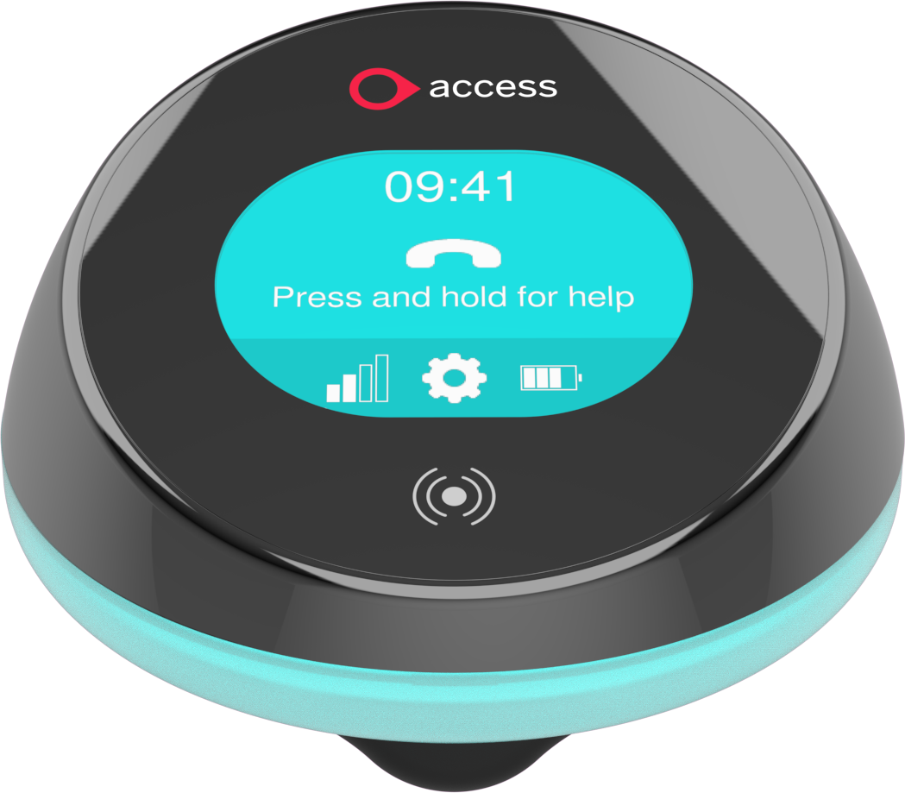
Access Home Hub hardware capabilities
Connects to
Alarm devices using 869MHz.
Activity devices using Zigbee
Health devices using Bluetooth
RFID reader
4G cellular networks

Slide 8
Service models
Service | Harware | Services | Other options
Protect (alarm services) | Hub and pendant with optional telecare devices | Alarms delivered to ARC Platform App Cellular connectivity Hardware warranty | Additional benefits include enhanced levels of support and training. Flexpoints
Prevent (activity services) | Hub and activity sensors | Alerts and Smart Alerts Platform App Cellular connectivity Hardware warranty
Predict (both activity and alarm services) | Hub, pendant, optional telecare sensors, and activity sensors | Alarms delivered to ARC Alerts and Smart Alerts Platform App Cellular connectivity Hardware warranty

Slide 9
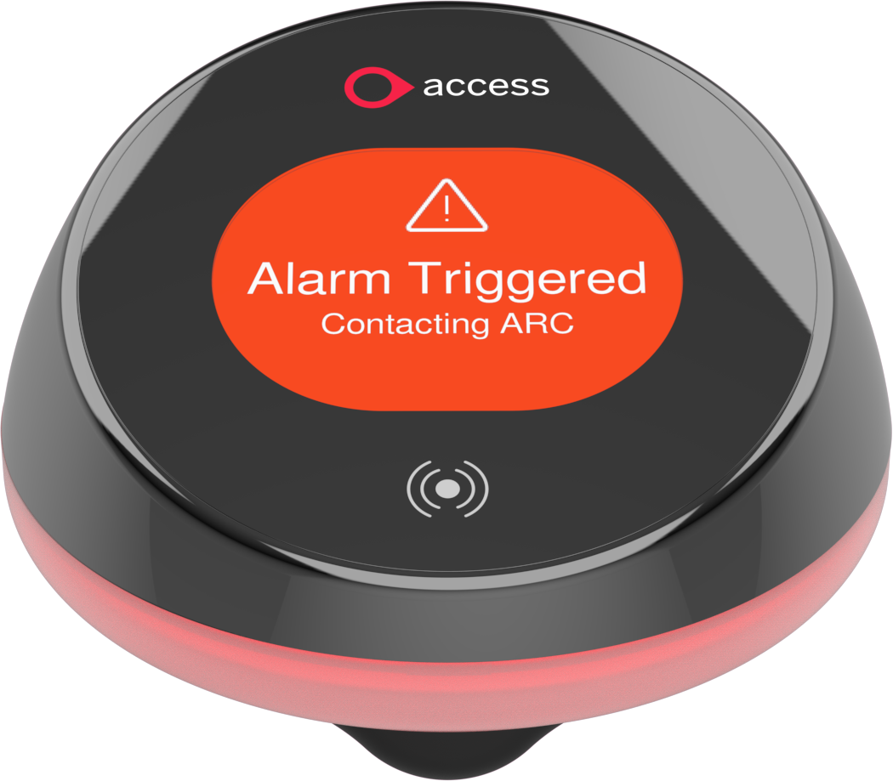
Alarm signalling
Alarm signalling using Cenelec (TS 50134-9) and Scaip
Compatible with Enovation UMO monitoring centres
Volume in active use connected to ARCs in 100’s, moving to 1,000’s this year.

Slide 10
Improving outcomes for all stakeholders
Family & Friends
Positive reassurance
Alerts to changes
Early and pre-emptive interventions
Reassurance of alarm safety net
Provides confidence to continue with normal lifestyle
Health Care
Avoiding hospital admissions
Enabling quicker hospital discharge
Support AHP’s in the community
Preventative and integrated approach
Person
Confidence
Reassurance
Independence
Social Care
Improved assessment
Care planning and review
Increased quality
Better use of resources and increased capacity
Preventative and integrated approach using strengths
Service Provider
Digital services
Consumer focused
Opportunity for new services
Future proof
Simpler installation
More engaged stakeholders
Greater integration with Commissioners

Slide 11

Proud to be a TSA Headline Sponsor
Join us at this industry leading two-day event dedicated to helping social care, housing, health and TEC professionals deliver proactive, preventative digital services.

Slide 12
Thanks!
E: Adrian.Scaife@theaccessgroup.com
T: 0743 528 3195

