Slide 1

Risk Management Toolkit
TSA 2022

Slide 2
Risk Management Tools & Templates
Tools & Templates included here:
Risk Maturity – Self Assessment tool
Sources of Risk - Checklist
TEC Sector Risks – 2021 Sector Survey summary
Risk Likelihood and Severity – Evaluation Tool
Risk Register - Template
Risk Incident Escalation - Template

Slide 3
1
Risk Management Maturity
Self Assessment Tool

Slide 4
Different levels of risk management maturity
Use the following slides to assess your organisational maturity
Enhanced
Intermediate
Proactive in risk management
Consistent, fully implemented processes
KRIs used for key risks
Senior management actively engaged
Rapid escalation
Deep review of Risk Incidents/Near Misses
Risk Maturity Level
Basic
Tone set at the top
Policies and procedures in place
Most processes implemented
Senior management engagement
Basic information reported
None
Risk applied inconsistently
Limited standardisation
Some formal processes
Reactive to adverse situations
Limited awareness of risk management
Many surprises
Reliant on heroics
Key Characteristics

Slide 5
Area | Basic | Intermediate | Advanced
Risk Ownership | No allocated ownership of risks within the organisation | Risk Champions (departmental) provide input to key risk activities: Risk Committee (cross-organisation) in existence and meeting regularly | Senior-level ownership and management of risk activities: Corporate understanding of the importance of risk management
Policies, Standards and Controls | Key organisational and operational risks identified and documented within a single register | Risk Register identified and recorded – inc. likelihood and severity of risks, causes of risk identified, consequences of risk materialising | Risk Register reviewed on ongoing basis and appropriate changes to activities and controls undertaken to reduce future risk
Governance 1 (Measurement) | No risk measurement | Key Risk Indicators (KRI) identified for each risk and measurement undertaken: reported to Management Team at least bi-annually | Quarterly KRI reporting to Board/Senior Management: Forecast of KRIs and KRI impact analysis undertaken prior to making key decisions
Governance 2 (Controls) | Risks identified but no control or mitigation measures aligned to risks | Pre-mitigation impact of risk identified & post-mitigation impact: Key risk controls specifically identified | Risk controls reviewed/tested on ongoing basis: “Worst Case Scenario” risk stress testing undertaken on key risks
Governance 3 (Risk Incidents) | No risk incident reporting: Knowledge of risk incidents retained locally/departmentally | “Near miss” potential risk review and capture process in place: Reported to Risk Committee for review on ongoing basis | Board-level bi-annual review of Risk Incident reporting, key trends, root cause analysis & development of new mitigating controls
Governance 4 (Regulatory) | No alignment of risks to any regulatory/guidance framework: Participate in annual TSA risk survey | Alignment of risks within framework of TSA QSF | Implementation of ISO3001 (Risk Management)
Risk Domains

Slide 6
Area | Basic | Intermediate | Advanced
Risk Actions Plans | No formal Action Plans exist to manage reduction of key identified risks | Formal Action Plan in place to implement improvements in risk and to develop new controls | Risk Action Plan reported to Board/Senior Management and subject to ongoing progress-tracking
Organisational Risk Appetite | Understanding of risk appetite but no officially set company policy on risk appetite | Risk appetite defined for key organisational activities | Risk appetite the subject of regular Board discussions: Risk incentives included within remuneration policy/approach
Training | Limited training delivered on importance of risk management and connection to good business practice | Risk training (basic) provided to selected staff – ie. how to identify a risk, how to record risk, how to mitigate risk | Risk training embedded within mandatory annual training: Comprehensive risk training for all staff (importance of risk management, managing risks, reviewing controls)
Emerging Risks | No consideration given to future/emerging risks: no formal process for identifying emerging risks | Future risks identified and reviewed as part of annual strategic plan | Long term market/organisational structural risks formally identified and considered by Board within 5 Year Plan
Risk Domains
Now evaluate what target level of maturity is appropriate for your organisation, and define action plans to get there.

Slide 7
2
Sources of Risk
Checklist

Slide 8
Risk Areas to Consider
Risk Category | Examples | Potential Impacts
Financial | Increased costs, loss of income, loss of margin | Inability to deliver service on a sustainable basis, contract renegotiation, price changes
Reputational | Customer and market perception, quality of service, adverse publicity | Loss of customer confidence in service, contract renegotiation, reputation of TEC industry impacted
Legal | Failure to meet legal requirements, product liability | Loss of commissioned contracts, regulatory fines (ie. ICO), product recalls, customer impact from non-delivery of product service
Regulatory | Standards compliance, TSA QSF | Loss of TSA QSF accreditation, external investigation (ie. ICO), external fines
Sales | Contract non-compliance, unable to deliver service, quality of service | Loss of commissioned contracts, inability to bid for new contracts, financial impact of reduced customer flow, inability to meet TSA requirements
Staff | Risk of harm, loss of staff, skills gaps | Inability to deliver quality service to Service Users leads to health impacts/harm, reduced staffing means inability to correctly staff 24/7 presence
Operational | Disruption, business continuity, loss of staff, supply failure/shortages | Requirement to institute Business Recovery Plan (BCP), interruptions to customer service could impact lived experience of Service Users, potential health impacts for service users
Productivity | Loss of staff, degraded efficiency, lack of integration | Inability to provide quality service to Service Users and potential health impacts, loss of commissioned contracts due to non-delivery of Service Level Agreement (SLA)
Project | Delay, cost increase, write off | Financial impact due to non-delivery, reduced revenue due to poor implementation

Slide 9
Types of Risk to Consider
Risk Category | Examples | Potential Impacts
Data | Data compromised, data access, data loss, unable to analyse & exploit data | ICO reports, ICO fine, customer data exposed via cyber-risk (including denial of service via ransomware)
Customer | Risk of harm to service user, failure to deliver as promised, failure to meet needs | Service User harm, external investigation of service, loss of commissioned contracts
Business Plan | Roadmap impact, failure to deliver new market propositions to plan | Business stagnation and failure to respond to changing market trends, reduced financial performance/sustainability
Market | Issues impacting market value, failure to meet market needs, market disruption | Reduced commercial sustainability, lack of innovation, through failure to understand changing customer needs
Technology | Analogue to Digital Transition, interoperability, cyber threats | Inability to successfully transition customers through to new digital age, inability to take hold of new digital opportunities, additional cost of digital equipment compromises/changes customer price

Slide 10
Potential causes of risk
Internal | People | Inappropriate level of resources
 |  | Inadequately skilled people
 |  | Inadequately managed people
 |  | Intentional act
 |  | Unintentional acts
 | Process | Inadequate process or control design
 |  | Ineffective process
 |  | Lack of process
 | Systems | Inadequately designed systems
 |  | Inadequately maintained systems
External Causes |  | Natural environment
 |  | Technological
 |  | Cultural
 |  | Regulatory
 |  | Supplier
 |  | Customer
 |  | Third party distribution

Slide 11
3
TEC Sector Risks
2021 survey results

Slide 12
2021 Risk Survey Short-Term Risks
1 to 2 years

Slide 13
Short-Term Risks (1-2 years)
Interoperability
  of TEC services with health and care
Work has focused on interoperability WITHIN telecare systems, and not addressed the wider issues of interoperability and integration of TEC services across health and social care to the same degree.
2. Digital Propositions
  limited, costly,
  unreliable?
‘Digital’ features heavily in the risk list, despite great efforts. A need for more focus and urgency?
3. The “3Ps” emerge
  Personalized, Preventative, Proactive
Personalized, Preventative and Proactive care models have come to the fore during COVID-19.
Are new care models supported with adequate guidance & standards?

Slide 14
2021 Risk Survey Emergent Risks
2 to 5 years

Slide 15
Emergent Risks (2-5 years)
4. Co-production
  with end-users, families and frontline care workers
Top of the list of emergent risks – will TEC services continue to be purchased if they are not viewed as relevant and co-produced?
5. Data
  Data play an increasing role in supporting health and care services
We may fail to exploit shared data and ‘big data’ to good effect.
6. Cyber security
  Negative ‘flip-side’ of digitization and data use
Are processes and controls in place?
Is there adequate support and guidance?

Slide 16
4
Risk Likelihood & Severity
Evaluation tool

Slide 17
Defining Risk Likelihood & Severity
Key considerations in understanding risks is that we should be able to identify both the “Likelihood” of a risk actually occurring and the “Severity” of the impact if that risk did happen.
It is the combination of Likelihood and Severity that dictates the impact of a particular risk. Within the Risk Matrix templates we have included a means of measuring these.
HOWEVER, you will need to undertake your own assessment of each of the levels of Likelihood & Severity. When measuring Severity you may want to identify this for EACH of the risks differently, as the impact will be felt in different ways. You now have a template list of Risk Areas and you may want different levels for each (example: the definition of severity may vary for example between Financial impact and Reputational impact).
To aid you, we have included examples below:
LIKELIHOOD
Very Frequent | At least monthly
Frequent | Annually
Infrequent | Between 1-5 years
Remote | 5 years+
SEVERITY
Not Significant | Minor | Serious | Very Serious | Extremely Serious
Less than £10k | £10-50k | £50-100k | £100-250k | £250k+
Examples
Examples

Slide 18
Risk Impact - Mapping Matrix
Now you can assess impact by combining Likelihood and Severity.
Using the matrix below, you can allocate your risks according to their relative Likelihood and Severity of a risk occurring, so you can prioritise your focus to reduce or mitigate the risks appropriately.
Each risk can now be categorised in terms of its impact (black-critical, red, amber, green)
Very Frequent
 |  | Risk Y
 | Risk X
 |  |  |  | Risk Z
Frequent
Likelihood
Infrequent
Remote
Not Significant
Minor
Serious
Very Serious
Extremely Serious
Severity

Slide 19
5
Risk
Register
Template

Slide 20
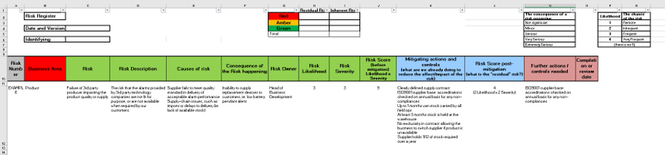
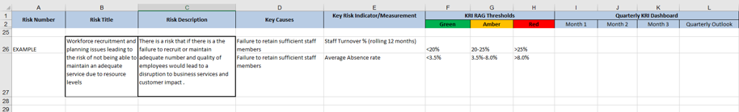
Risk Register template
This template may be useful within your management processes. It provides a format for capturing a register of the risks identified, the associated action plans and Key Risk Indicators (KRI).
See the spreadsheet version that we have provided in the toolkit.

Slide 21
6
Risk
Incident Escalation
Template

Slide 22
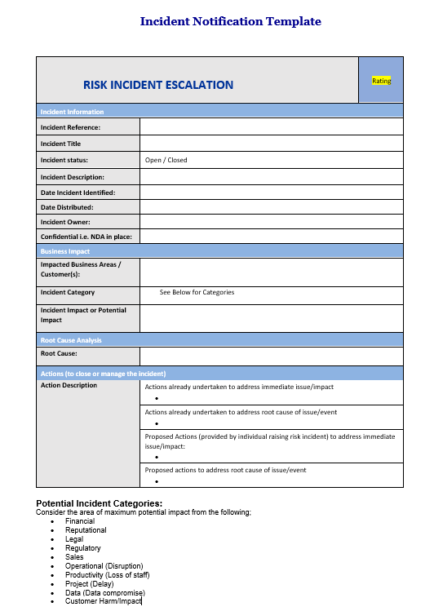
Risk Incident
Escalation template
This Incident Escalation template may be useful within your management processes.
See the word version that we have provided in the toolkit.

Slide 23
Acknowledgements
TSA wish to thank all the people and organisations that contributed to the work of ‘Special Interest Group 14 – Risk Management’.
Particular thanks go to Taking Care for their work on various templates for the risk toolkit.

